Slide 1
Lecture 1
Alt. Representation, CSE250 Review, IV Characteristics

Slide 2
Outline
Alternative Circuit Representation – Line diagrams
CSE250 Review
- KCL, KVL
- Series, Parallel resistor network – Voltage Division, Current division
- Examples
IV Characteristics
- Linear IV – Resistors, Voltage Source, Current Source, SC, OC.
- Non-Linear IV – Piecewise Linear Model

Slide 3
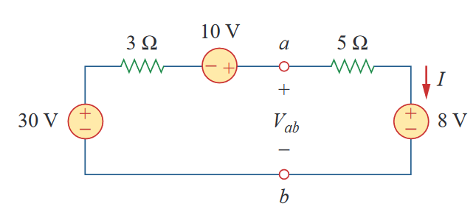
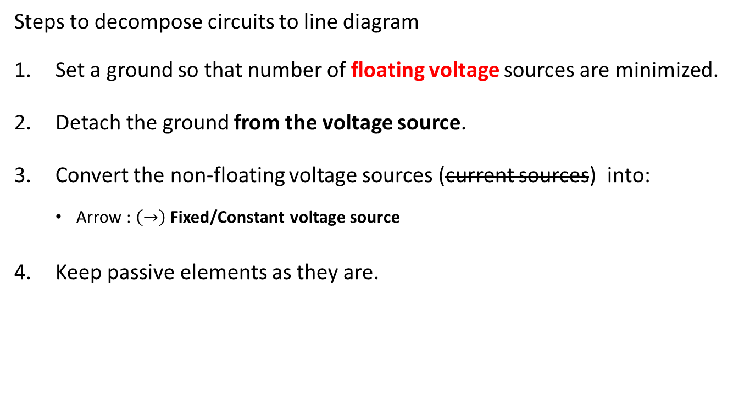
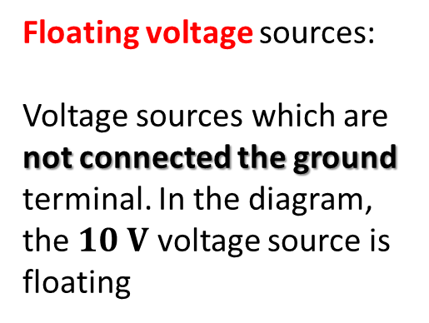
Alternative Circuit Representation: Line diagrams
Steps to decompose circuits to line diagram
Set a ground so that number of floating voltage sources are minimized.
Detach the ground from the voltage source.
Convert the non-floating voltage sources (current sources) into:
Arrow : $\left(→\right)$ Fixed/Constant voltage source
Keep passive elements as they are.
Floating voltage sources:
Voltage sources which are not connected the ground terminal. In the diagram, the $10 V$ voltage source is floating

Slide 4
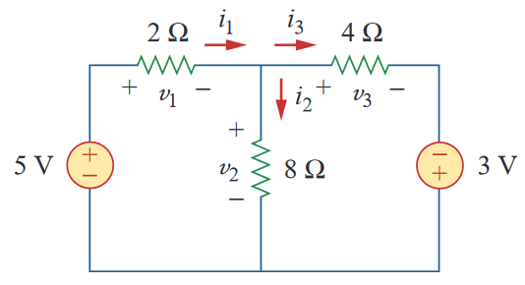





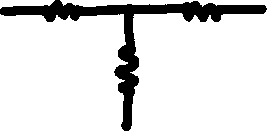









Line diagrams: Example 1
$$2 kΩ$$
$$4 kΩ$$
$$2 kΩ$$
$$4 kΩ$$
$$5 V$$
$$3 V$$
$$8 kΩ$$
$$8 kΩ$$
$$2 kΩ$$
$$4 kΩ$$
$$5 V$$
$$−3 V$$
$$8 kΩ$$

Slide 5













Line diagrams: Example 2
$$10 V$$
$$3 Ω$$
$$5 Ω$$
$$30 V$$
$$8 V$$
$$10 V$$
$$3 Ω$$
$$5 Ω$$
$$30 V$$
$$8 V$$

Slide 6

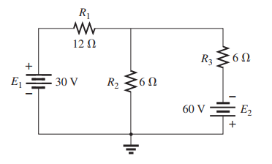
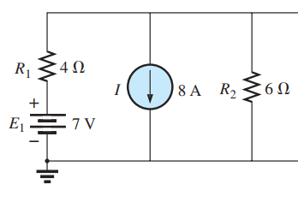
More Examples
Difficulty : 2/5
Difficulty : 3/5
Example: 2
Example: 3

Slide 7
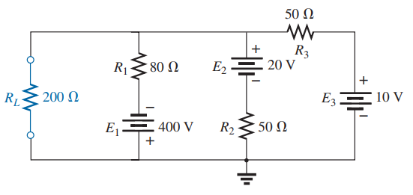
More Examples
Difficulty : 4/5
Step – (4) Make all the active elements (dc/ac type, voltage/current sources) into single terminals (arrows/circles) using the voltages you wrote as much as you can [THERE MIGHT BE CASES WHERE YOU CAN’T DO THAT]
Example: 4

Slide 8
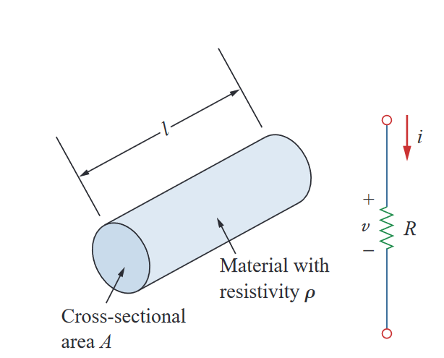


The fundamentals …
Ohm’s Law –
the voltage $v$ across a resistor is directly proportional to the current $i$ flowing through the resistor ($R$)
$$v∝i$$
$$v=iR$$

Slide 9
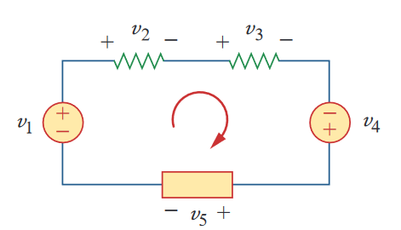


KVL: Kirchhoff’s voltage law
The algebraic sum of all voltages around a closed path (or loop) is zero.
$$−v_{1}+v_{2}+v_{3}−v_{4}+v_{5}=0$$
$$v_{2}+v_{3}+v_{5}=v_{1}+v_{4}$$
Sum of voltage drops = Sum of voltage rises

Slide 10
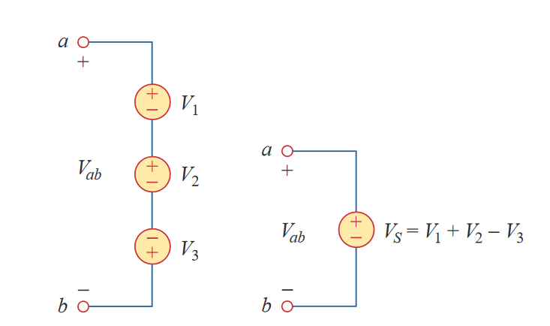


KVL: Kirchhoff’s voltage law
$${−V}_{ab}+V_{1}+V_{2}−V_{3}=0$$
$$V_{ab}=V_{1}+V_{2}−V_{3}$$
Equivalent Circuits

Slide 11

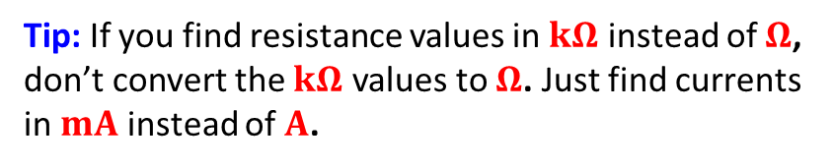
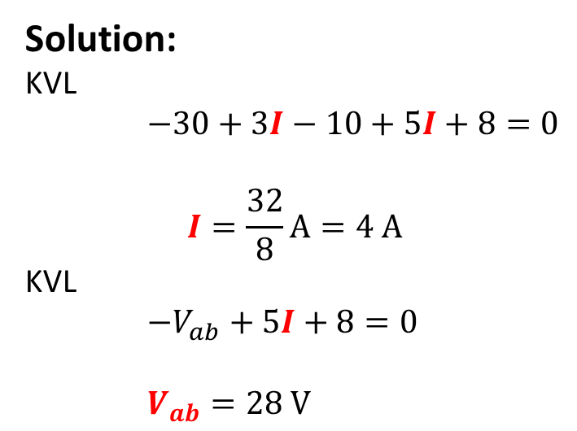
KVL – Example 1
Find $I$ and $V_{ab}$ in the circuit
Solution:
KVL
$−30+3I−10+5I+8=0$
$$I=\frac{32}{8}A=4 A$$
KVL
$−V_{ab}+5I+8=0$
$V_{ab}=28 V$
Tip: If you find resistance values in $kΩ$ instead of $Ω$, don’t convert the $kΩ$ values to $Ω$. Just find currents in $mA$ instead of $A$.

Slide 12

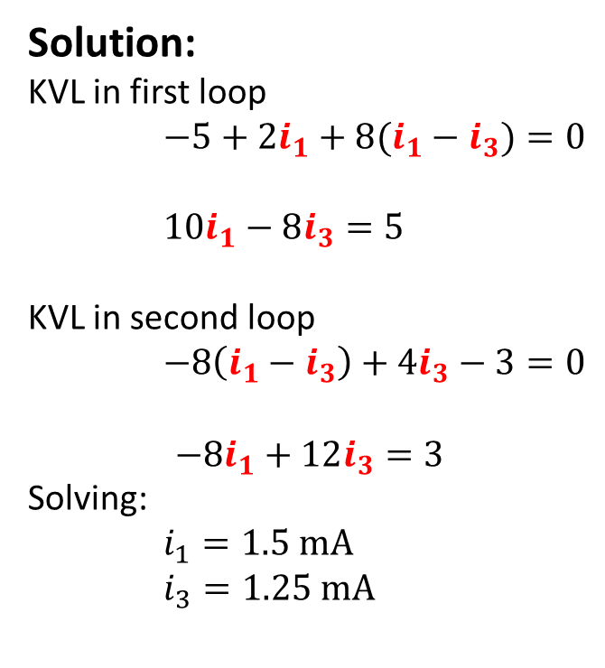





KVL – Example 2
Find $v_{1},v_{2}, v_{3}, i_{1}, i_{2}$ and $i_{3}$ in the circuit
Solution:
KVL in first loop
$−5+2i_{1}+8(i_{1}−i_{3})=0$
$10i_{1}−8i_{3}=5$
KVL in second loop
$−8\left(i_{1}−i_{3}\right)+4i_{3}−3=0$
$$−8i_{1}+12i_{3}=3$$
Solving:
$i_{1}=1.5 mA$
$i_{3}=1.25 mA$
$$2 kΩ$$
$$4 kΩ$$
$$8 kΩ$$
Tip: If you find resistance values in $kΩ$ instead of $Ω$, don’t convert the $kΩ$ values to $Ω$. Just find currents in $mA$ instead of $A$.
$$v_{1}=3 V$$
$$v_{2}=2 V$$
$$v_{3}=5 V$$
$$i_{2}=i_{1}−i_{3}=0.25 mA$$

Slide 13
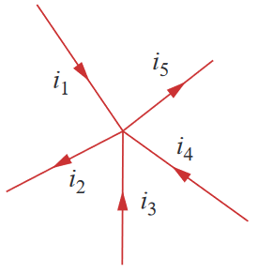
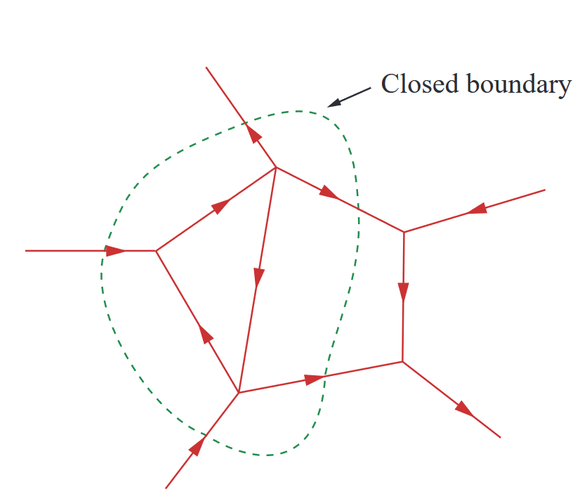

KCL: Kirchoff’s Current Law
The algebraic sum of the currents entering a node (closed boundary) is equal to the sum of the currents leaving the node.
$$i_{1}+\left(−i_{2}\right)+i_{3}+i_{4}+\left(−i_{5}\right)=0$$
Current Entering node: Positive
Current Exiting node: Negative
Or vice versa…

Slide 14

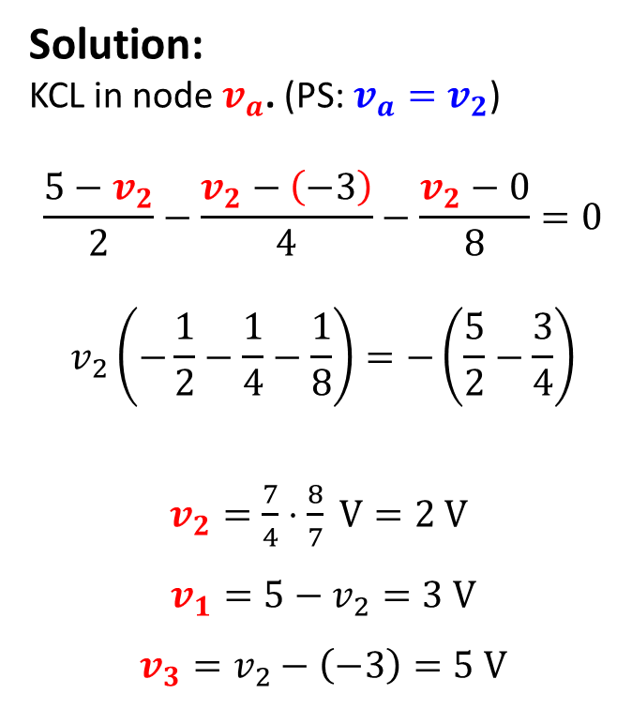
KCL- Example 1
Find $v_{1},v_{2}, v_{3}, i_{1}, i_{2}$ and $i_{3}$ in the circuit
Solution:
KCL in node $v_{a}$. (PS: $v_{a}=v_{2}$)
$$\frac{5−v_{2}}{2}−\frac{v_{2}−\left(−3\right)}{4}−\frac{v_{2}−0}{8}=0$$
$$v_{2}\left(−\frac{1}{2}−\frac{1}{4}−\frac{1}{8}\right)=−\left(\frac{5}{2}−\frac{3}{4}\right)$$
$v_{2}=\frac{7}{4}⋅\frac{8}{7} V=2 V$
$$v_{1}=5−v_{2}=3 V$$
$$v_{3}=v_{2}−\left(−3\right)=5 V$$
$$2 kΩ$$
$$4 kΩ$$
$$v_{a}$$
$$8 kΩ$$

Slide 15
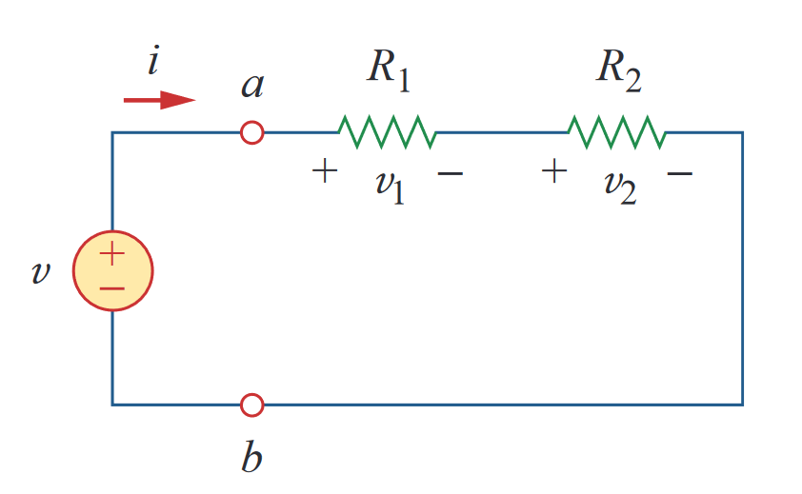
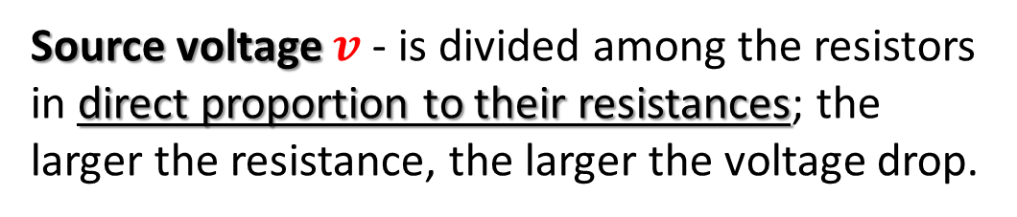
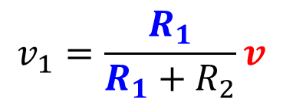
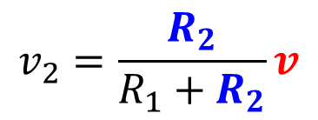

Series Resistors and Voltage Division
The equivalent resistance of any number of resistors connected in series is the sum of the individual resistances.
Principle of voltage division
Source voltage $v$ - is divided among the resistors in direct proportion to their resistances; the larger the resistance, the larger the voltage drop.
$$v$$
$$v_{1}=\frac{R_{1}}{R_{1}+R_{2}}v$$
$$v_{2}=\frac{R_{2}}{R_{1}+R_{2}}v$$

Slide 16

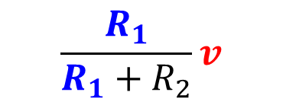

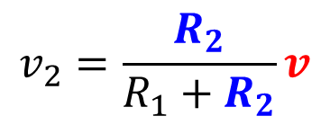
Line diagram: Example 3
$$v$$
}
$$\frac{R_{1}}{R_{1}+R_{2}}v$$
{
$$v$$
$$v_{2}=\frac{R_{2}}{R_{1}+R_{2}}v$$

Slide 17
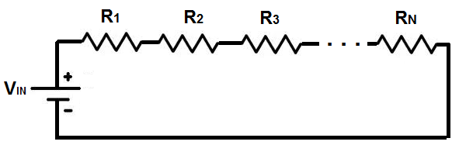



Series Resistors and Voltage Division
If there are $N$ resistors in series, the voltage across the $i$–th resistor is given by,
As $V∝R$
$$v_{i}=\frac{R_{i}}{\sum_{i}{R_{i}}}v_{in}$$
$$v_{in}$$

Slide 18


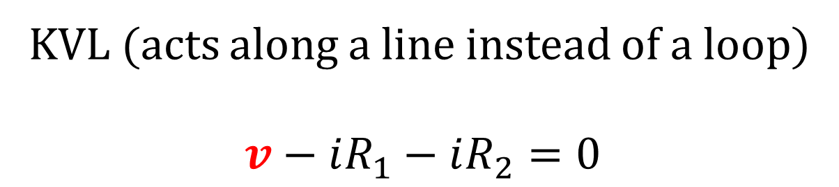
Line diagram: Example 3
$$v$$
}
{
$$v$$
KVL (acts along a line instead of a loop)
$$v−iR_{1}−iR_{2}=0$$

Slide 19
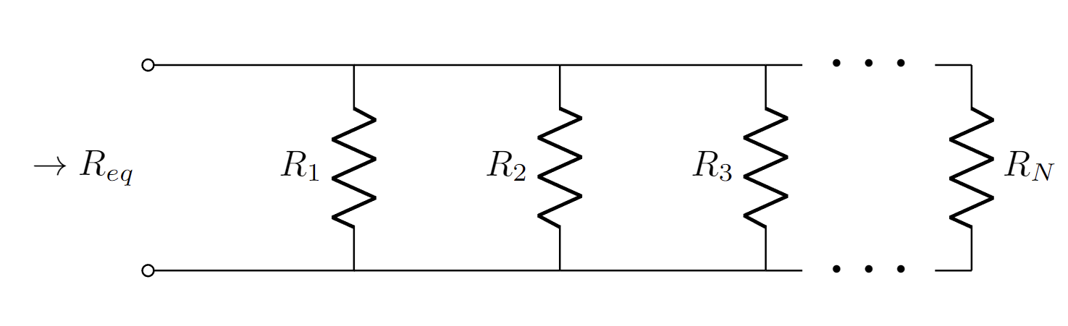
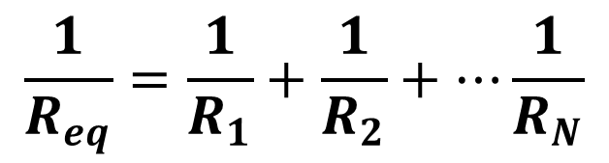
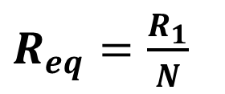
Parallel Resistors and Current Division
The equivalent resistance of any number of resistors connected in parallel is the inverse of the sum of the individual conductances.
$$\frac{1}{R_{eq}}=\frac{1}{R_{1}}+\frac{1}{R_{2}}+⋯\frac{1}{R_{N}}$$
Simplification for the case when $R_{1}=R_{2}=R_{3}⋯=R_{N}$
$R_{eq}=\frac{R_{1}}{N}$

Slide 20
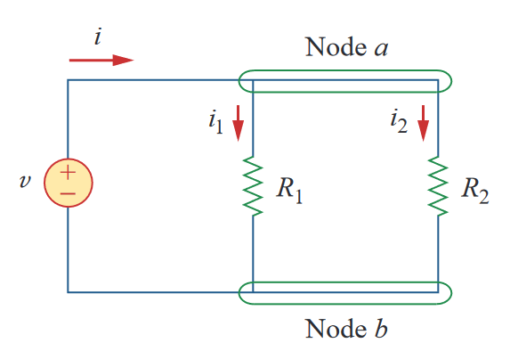

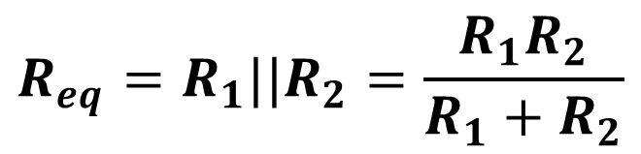
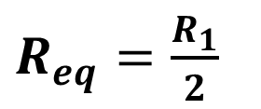
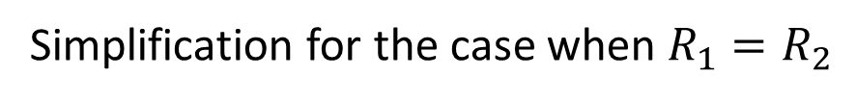
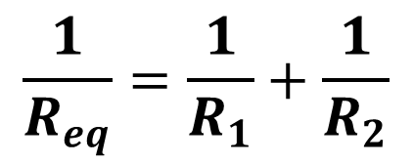
Parallel Resistors and Current Division
The equivalent resistance of any number of resistors connected in parallel is the inverse of the sum of the individual conductances.
$$\frac{1}{R_{eq}}=\frac{1}{R_{1}}+\frac{1}{R_{2}}$$
$$R_{eq}=R_{1}||R_{2}=\frac{R_{1}R_{2}}{R_{1}+R_{2}}$$
$$i$$
Simplification for the case when $R_{1}=R_{2}$
$R_{eq}=\frac{R_{1}}{2}$

Slide 21
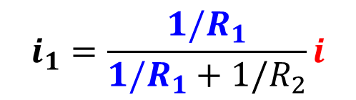
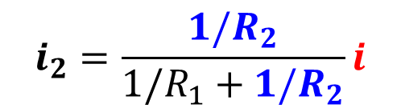

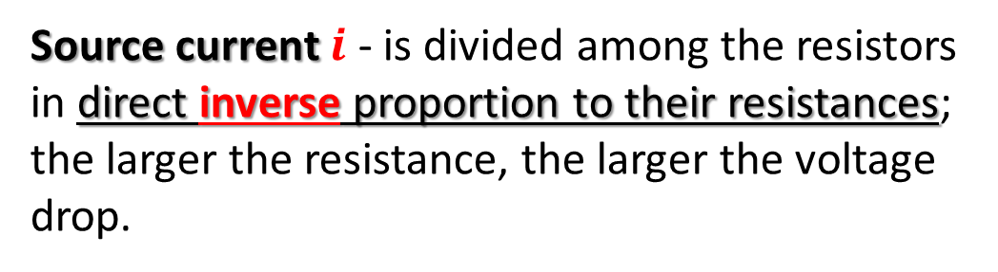
Parallel Resistors and Current Division
The equivalent resistance of any number of resistors connected in parallel is the inverse of the sum of the individual conductances.
$$i$$
Principle of current division
Source current $i$ - is divided among the resistors in direct inverse proportion to their resistances; the larger the resistance, the larger the voltage drop.
$$i_{1}=\frac{1/R_{1}}{{1/R}_{1}+{1/R}_{2}}i$$
$$i_{2}=\frac{1/R_{2}}{{1/R}_{1}+1/R_{2}}i$$

Slide 22
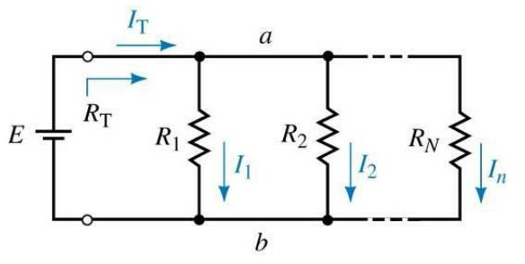


Parallel Resistors and Current Division
If there are $N$ resistors in parallel, the current through the $i$–th resistor is given by, $i∈\{1,2,3,⋯N\}$
As $I∝\frac{1}{R}$
$$I_{i}=\frac{{1/R}_{i}}{\sum_{i}{{1/R}_{i}}}I_{T}$$

Slide 23
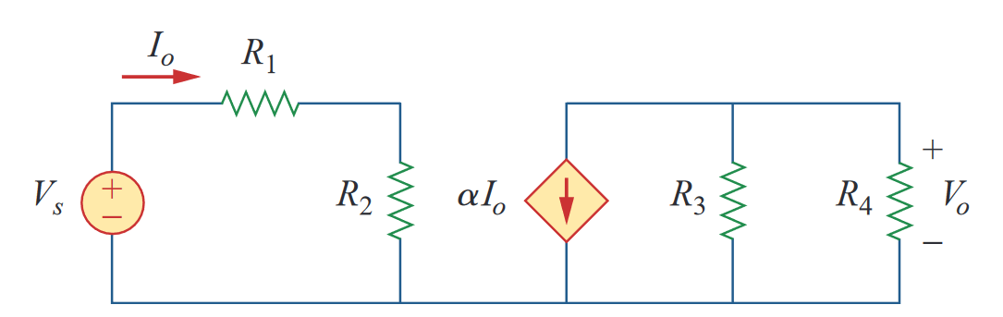



Line diagrams: Example 4

Slide 24



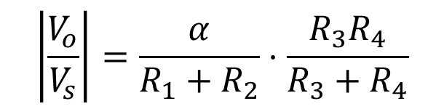

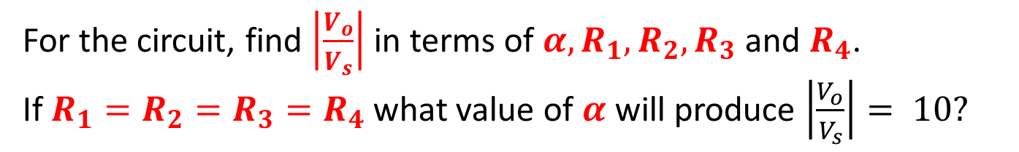
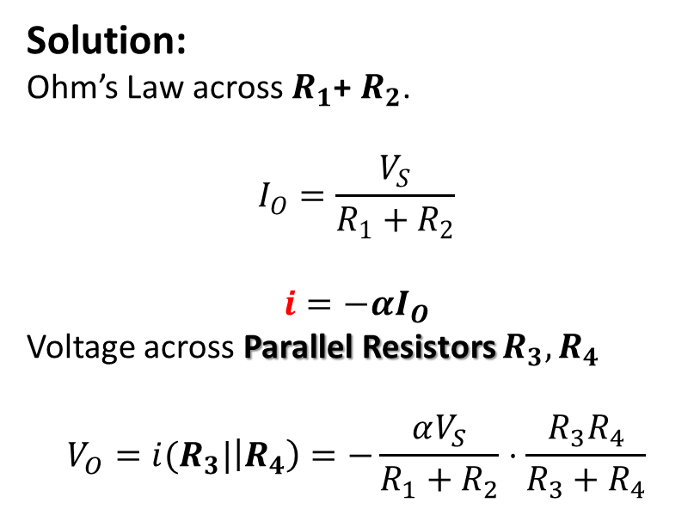
Practice Problem 1
For the circuit, find $\left|\frac{V_{o}}{V_{s}}\right|$ in terms of $α, R_{1}, R_{2}, R_{3}$ and $R_{4}$. If $R_{1}=R_{2}=R_{3}=R_{4}$what value of $α$will produce $\left|\frac{V_{o}}{V_{s}}\right|= 10?$
Solution:
Ohm’s Law across $R_{1}$+ $R_{2}$.
$$I_{O}=\frac{V_{S}}{R_{1}+R_{2}}$$
$$i=−αI_{O}$$
Voltage across Parallel Resistors $R_{3}, R_{4}$
$$V_{O}=i(R_{3}|\left|R_{4}\right)=−\frac{αV_{S}}{R_{1}+R_{2}}⋅\frac{R_{3}R_{4}}{R_{3}+R_{4}}$$
$$i$$
$$\left|\frac{V_{o}}{V_{s}}\right|=\frac{α}{R_{1}+R_{2}}⋅\frac{R_{3}R_{4}}{R_{3}+R_{4}}$$
$$α=40$$

Slide 25
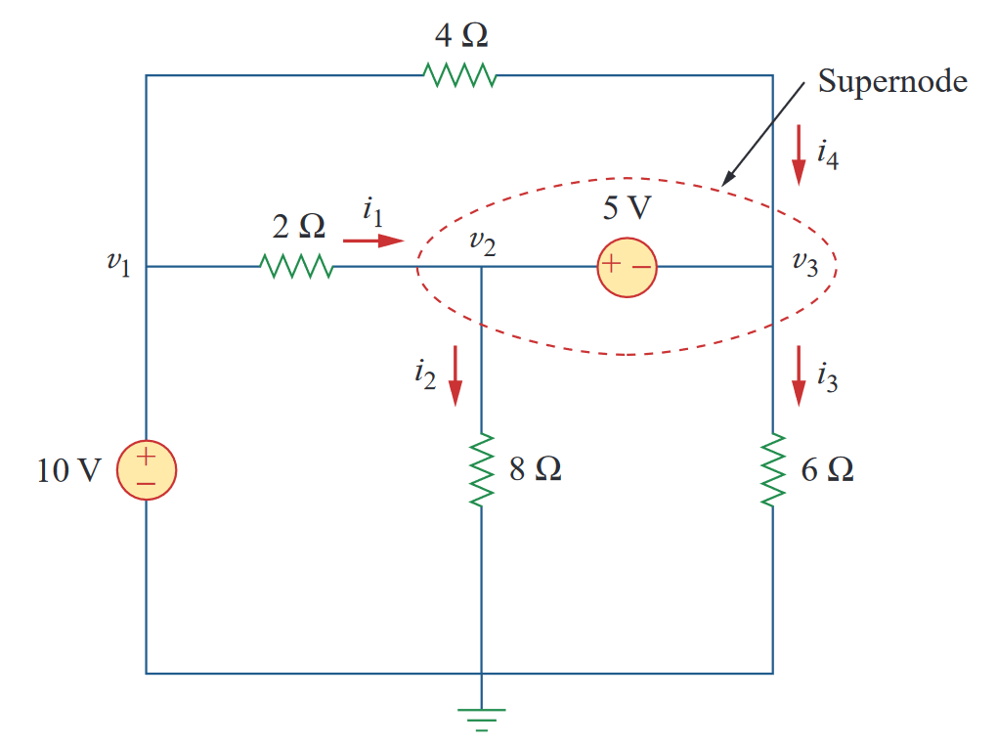
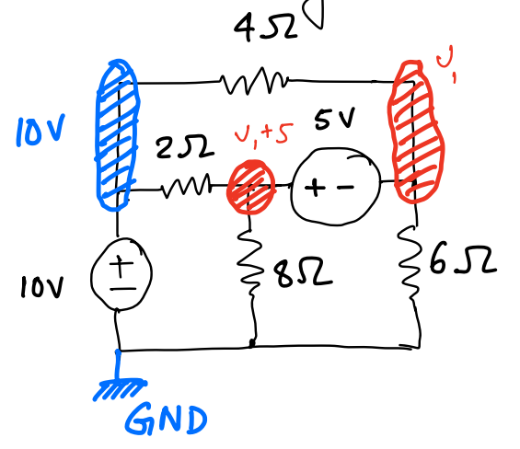


Example 1- Nodal Analysis

Slide 26














Example 1- Nodal Analysis
Node equation for node $v_{1}$
$$v_{1}\left(\frac{1}{4}+\frac{1}{6}\right)+\left(v_{1}+5\right)\left(\frac{1}{2}+\frac{1}{8}\right)−10\left(\frac{1}{2}+\frac{1}{4}\right)=0$$

Slide 27


Example 2- Nodal Analysis – Home Task 1
Find the two node $v_{1}$ and $v_{3}$ equations!

Slide 28











Example 3
KCL at node $v_{o}$
$$\frac{0.6−0.5}{5}=\frac{\left(0.5−0.7\right)−\left(−0.5\right)}{10}+I_{1}$$
$$I_{1}=−0.01 mA$$

Slide 29












Example 4
KCL at node $v_{i}$
$$\frac{2−v_{i}}{1}=\frac{v_{i}−v_{o}}{2}+\frac{v_{i}}{200}$$
$${\frac{301}{200}v}_{i}−\frac{1}{2}v_{o}=2$$
KCL at node $v_{o}$
$$\frac{v_{i}−v_{o}}{2}+\frac{Av_{i}−v_{o}}{0.1}=0$$
$$\left(2×{10}^{6}+0.5\right)v_{i}−10.5v_{o}=0$$

Slide 30










Example 5
KCL at node $v_{i}$
$$\frac{0−v_{i}}{5}=\frac{v_{i}−v_{o}}{40}+\frac{v_{i}−1}{200}$$
$${\frac{23}{100}v}_{i}−\frac{1}{40}v_{o}=\frac{1}{200}$$
KCL at node $v_{o}$
$$\frac{v_{i}−v_{o}}{40}+\frac{Av_{i}−v_{o}}{0.1}=\frac{v_{o}}{20}$$
$$\left(2×{10}^{6}+0.025\right)v_{i}−10.075v_{o}=0$$

Slide 31









Example 6 – Home Task 2
For $R=100 Ω$, $R_{L}=10 kΩ$, $r_{z}=20 Ω$, $V_{ZO}=3 V$, and $I_{Z}=1 mA$.
Find $V_{O}$
Find $I_{L}$
Find $I$
Find $V^{+}$

Slide 32
Current-Voltage (I-V) Characteristics
I-V characteristic defines the relationship between the current flow (through), I and voltage (across), V an electronic device or element.
A tool for understanding the operation of the circuit element.
The Current-Voltage (I-V) characteristics are found by evaluating the response of a device/element under different excitation conditions. The behavior of a device depends on the applied excitation and can change if the excitation changes.

Slide 33


Current-Voltage (I-V) Characteristics
Example:

Slide 34




Current-Voltage (I-V) Characteristics
$$I=kV$$
$$y=mx$$
$$I=kV^{2}$$
$$y=ax^{2}$$
$$I=A⋅exp⁡(\frac{V}{b})$$
$$y=A⋅exp⁡(\frac{x}{b})$$

Slide 35

Type of (I-V) Characteristics
1. Linear Devices/Elements: The Current-Voltage relationship is linear i.e. the current through the element is a linear function of the applied voltage across it. The relationship can be characterized by:
$$I=kV$$
2. Non-Linear Devices/Elements: The Current-Voltage relationship is Non-linear i.e., the current through the element is a nonlinear function of the applied voltage across it.
$$I=k\sqrt{V}$$
$$I={kV}^{2}$$
$$I=kV^{3}$$

Slide 36

Type of (I-V) Characteristics
Identify which of these I-V curves are Linear and which are Nonlinear

Slide 37

Linear Devices/Elements
Write down the slopes of these following regions in ascending order (you do not need to calculate the slopes)

Slide 38

Linear Devices/Elements
Find out the slope of the following curves

Slide 39


Linear Devices/Elements
For the lines represented by $y=mx+c$ what is the value of $c$ in the following figures [Figure (i), (ii) and (iii)]

Slide 40




Linear Devices/Elements:
Resistors
Current Source
Voltage Source

Slide 41





Resistor
The relationship between current, $I$ and voltage, $V_{d}$ in a resistor of value ‘R’ is defined by the “Ohm’s law”:
$$V_{d}=IR$$
$$⇒I=\frac{V_{d}}{R}$$
$$⇒I=\frac{1}{R}⋅V+0$$
$$y=m⋅x+c$$
I-V curve of a $2Ω$ resistor

Slide 42




Current Source
The value of current flow through a current source is FIXED and thus does not change with voltage. The equation is as follows
$$I=I_{0}$$
$$y=c$$
------------------------------
$$I=0⋅V_{d}+I_{0}$$
$$y=m⋅x+c$$
Slope: $m=0$
This curve intersects the y axis at $I=I_{0}$.

Slide 43




Voltage Source
The value of voltage across a voltage source is FIXED and thus does not change even if the current through the branch changes.
$$V=V_{0}$$
$$x=c$$
Slope: $m=∞$
This curve intersects the x axis at $V_{d}=V_{o}$.

Slide 44


Electrical Sources
Ideally, internal resistance of a CURRENT SOURCE is infinite (undefined)
That of a VOLTAGE SOURCE is zero
Resistance: $∞$
Resistance: $0$

Slide 45

Hybrid/ Compound Linear Circuits
Voltage Source in Series with a Resistor
Current source in Parallel with a Resistor

Slide 46




Voltage Source in Series with a Resistor
$$V_{d}−V_{o}= IR$$
$$⇒I=\frac{V_{d}−V_{o}}{R}$$
$$⇒I=\frac{1}{R}⋅V_{d}−\frac{Vo}{R}$$
$$y=mx+c$$
$$m=\frac{1}{R}$$
$$c=−\frac{V_{0}}{R}$$
I-V curve of a $4 kΩ$ resistor in series with a $2$ V voltage source

Slide 47



Current source in Parallel with a Resistor
$$I=\frac{V_{d}}{R}+I_{0}$$
$$⇒I=\frac{1}{R}⋅V_{d}+I_{0}$$
$$y=mx+c$$
$$m=\frac{1}{R}$$
$$c=I_{0}$$
The value of a resistor CAN NOT be Negative!

Slide 48






Degenerate Linear Elements
Open Circuit
Short Circuit
$$I_{d}=I_{0}=0$$
$$y=c=0$$
$$V=V_{0}=0$$
$$x=c=0$$

Slide 49


Voltage Source in Series with a Resistor
Find the circuit

Slide 50


Current source in Parallel with a Resistor
Find the circuit

Slide 51

Practice Problems
1. A Voltage Source, $V_{o}= −10$V in series with a resistor of $R= 3$ k$Ω$.
Write down the equation representing this curve
Determine the unknown parameters
Label the I-V curve
2. A Current Source, $I_{o}= −5$ mA in parallel with a resistor of $R= 5$ k$Ω$.
Write down the equation representing this curve
Determine the unknown parameters
Label the I-V curve
3. A Current Source, $I_{o}= 5$mA in parallel with a resistor. The slope of the curve is, $m= −5 {kΩ}^{−1}$.
Write down the equation representing this curve
Determine the unknown parameters
Label the I-V curve

Slide 52






Non-Linear Devices/Elements
Diode
MOSFET
BJT

Slide 53

Piecewise Linear Approximation for NL devices
Simplifying non-linear IV characteristics by piecewise linear parts.
Non-linear functions are usually approximated by a series of linear segments that follow the tangent of the non-linear segment as can be seen from the following figure.

Slide 54

Piecewise Linear Approximation for NL devices

Slide 55


Piecewise Linear Approximation for NL devices

